Slide 1
Machine learning
Regent College London
SWE6204

Slide 2
Machine learning
SWE6204

Slide 3

Machine learning
REGRESSION METHODS

Slide 4
Module – LINEAR REGRESSION

Slide 5
Learning objectives
Understand the Linear Regression
Understand the the Linear Regression Loss
Understand R-Squared Error
Linear Regression Python example

Slide 6
REGRESSION
Regression is a method of modeling a target value based on independent predictors
It is a statistical tool which is used to find out the relationship between the outcome variable also known as the dependent variable, and one or more variable often called as independent variables
This method is mostly used for forecasting and finding out cause-and-effect relationships between variables
Regression techniques mostly differ based on the number of independent variables and the type of relationship between the independent and dependent variables.
Notes:
https://www.mygreatlearning.com/blog/linear-regression-in-machine-learning/
Regression method tries to find the best fit line which shows the relationship between the dependent variable and predictors with least error.
In regression, the output/dependent variable is the function of an independent variable and the coefficient and the error term.

Slide 7
REGRESSION
Regression method tries to find the best fit line which shows the relationship between the dependent variable and predictors with least error.
In regression, the output/dependent variable is the function of an independent variable and the coefficient and the error term.
Linear Regression is the basic form of regression analysis. It assumes that there is a linear relationship between the dependent variable and the predictor(s).

Slide 8
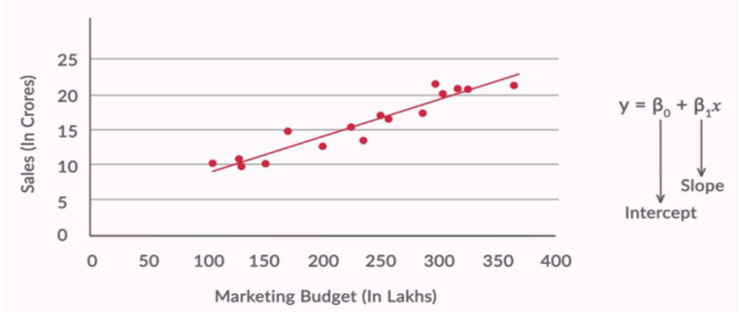

REGRESSION
Through the best fit line, we can describe the impact of change in independent variables on the dependent variable.

Slide 9
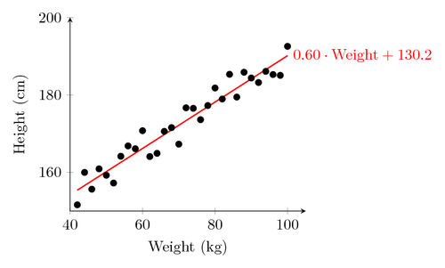
REGRESSION
Fit a line to a data set of observations
Use this line to predict unobserved values

Slide 10
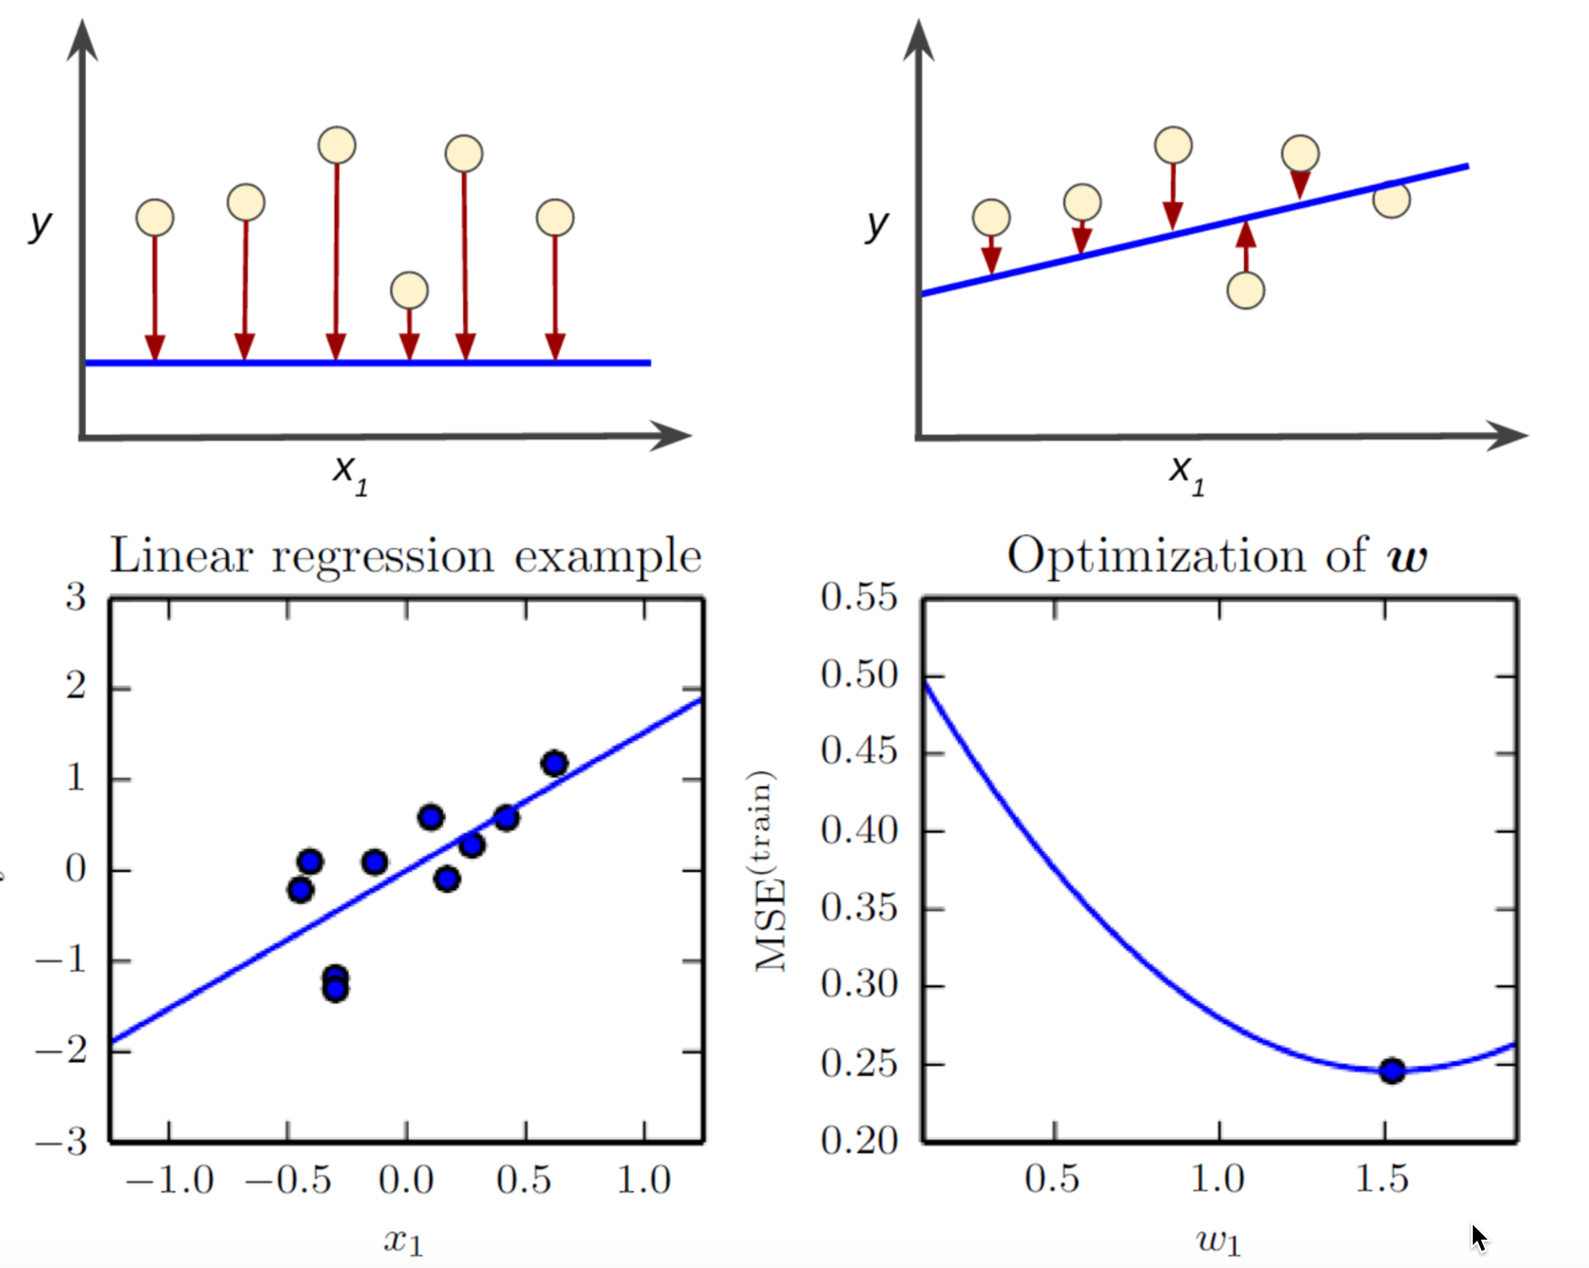
Minimise the loss

Slide 11
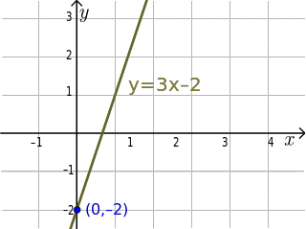
Linear regression technique i
Usually using “least squares”
Minimizes the squared-error between each point and the line
Remember the slope-intercept equation of a line? y=mx+b
The slope is the correlation between the two variables times the standard deviation in Y, all divided by the standard deviation in X.

Slide 12
Linear regression technique ii
Neat how standard deviation how some real mathematical meaning, eh?
The intercept is the mean of Y minus the slope times the mean of X
But Python will do all that for you.

Slide 13
How does it work
Least squares minimizes the sum of squared errors.
This is the same as maximizing the likelihood of the observed data if you start thinking of the problem in terms of probabilities and probability distribution functions
This is sometimes called “maximum likelihood estimation”

Slide 14
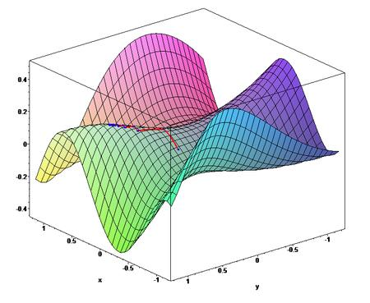
optimiser
Gradient Descent is an alternate method to least squares.
Basically, iterates to find the line that best follows the contours defined by the data.
Can make sense when dealing with 3D data
Easy to try in Python and just compare the results to least squares
But usually, least squares is a perfectly good choice.

Slide 15
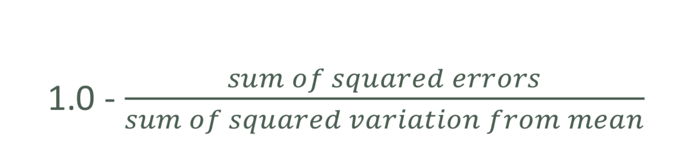
Measurement error with r-squared
How do we measure how well our line fits our data?
R-squared (aka coefficient of determination) measures:
The fraction of the total variation in Y that is captured by the model

Slide 16
Let’s play with an example.

Slide 17
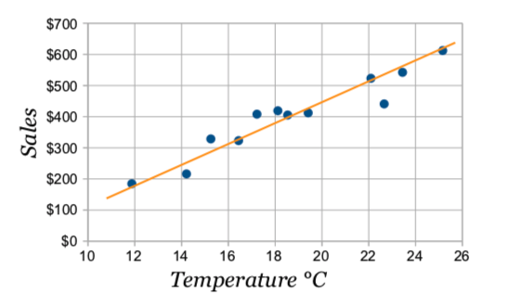
Least square regression-example
Line of Best Fit
Imagine you have some points, and want to have a line that best fits them like this:
Notes:
We can place the line "by eye": try to have the line as close as possible to all points, and a similar number of points above and below the line.

Slide 18
The line
Our aim is to calculate the values m (slope) and b (y-intercept) in the equation of a line : y = mx + b
Where:
y = how far up
x = how far along
m = Slope or Gradient (how steep the line is)
b = the Y Intercept (where the line crosses the Y axis)

Slide 19
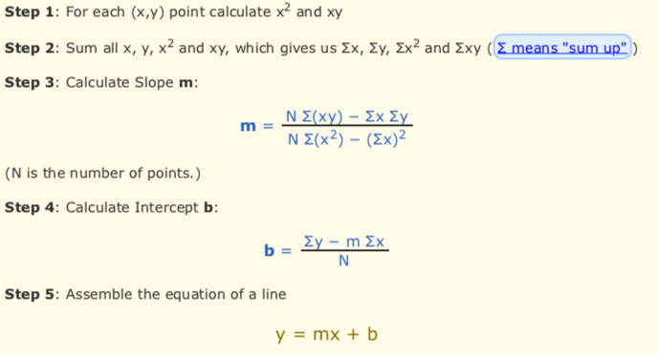
steps

Slide 20
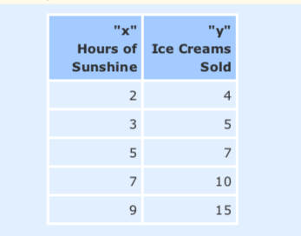
activity
Example: Sam found how many hours of sunshine vs how many ice creams were sold at the shop from Monday to Friday
Calculate Linear regression line using above equation

Slide 21
REFERENCE
https://towardsdatascience.com/laymans-introduction-to-linear-regression-8b334a3dab09#:~:text=Linear%20regression%20attempts%20to%20model,variable%20(e.g.%20your%20expenses).
https://www.mygreatlearning.com/blog/linear-regression-in-machine-learning/
https://www.youtube.com/watch?v=JvS2triCgOY
Notes:
Rishi Sidhu
Jun 5, 2019
·
·
Listen
Layman’s Introduction to Linear Regression

Slide 22
+44 (0)207 016 8000
info@rcl.ac.uk

